Slide 1
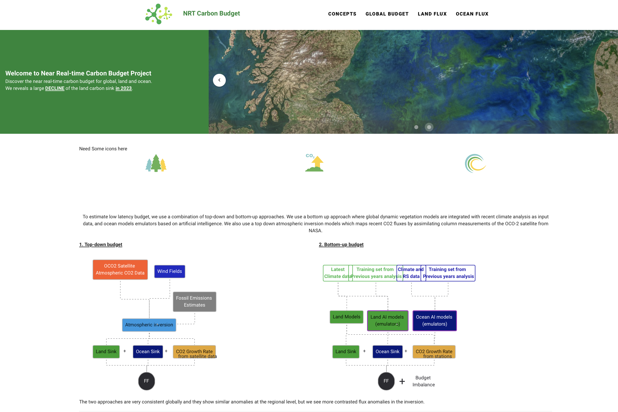
About us
The objective of the near real time global carbon budget research initiative is to monitor the fate of fossil CO2 emissions from human activities into the increase of CO2 in the atmosphere and the capture by ocean and land carbon sinks. Complementary to the annual Global Carbon Budget (link Friedlingsten paper ) , we provide each semester a synthesis of emissions and natural CO2 sinks using the latest atmospheric data and a suite of peer-reviewed modeling approaches (link piyu paper)
Two independent and complementary approaches are used to estimate the global CO2 budget and the regional distribution of emissions and natural CO2 sinks
The bottom up approach is based on near real time fossil CO2 emissions based on activity data from Carbon Monitor (link), atmospheric CO2 monthly increase from the NOAA and SCRIPPS network (link) , and process-based land carbon models integrated with the latest climate data as input, and AI-empowered emulators of ocean carbon models. The land and ocean carbon models used here are contributing to in the annual Global Budget assessment and have been extensively validated
The top down approach is based on satellite measurements of CO2 in the atmosphere with global coverage by the OCO2 satellite of NASA (link ) using an atmospheric inversion to translate these measurements into fluxes. It uses as input fossil CO2 emissions and the latest wind fields to provide time varying maps of land and ocean CO2 fluxes

Slide 2
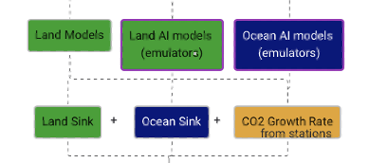

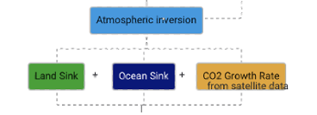
Bottom up
Top down
CO2 growth rate from
NOAA and SCRIPPS surface stations
OCO2 satellite data

Slide 3
Atmospheric Inversion Model
OCO-2 Satellite
Observations of atmospheric CO₂ concentration
Fossil Emissions
Land Sink
Ocean Sink
Atmospheric CO₂ Growth Rate
from OCO-2 data
Land Models
Land AI Models
(emulators)
Ocean AI Models
(emulators)
Fossil Emissions
Land Sink
Ocean Sink
Atmospheric CO₂ Growth Rate
from NOAA and SCRIPPS stations
+
Budget
Imbalance
=
+
+

Slide 4
Fossil Emissions
Estimates
Top down
Atmospheric Inversion Model
OCO2 Satellite Data
Bottom up
Land Sink
Ocean Sink
CO2 Growth Rate
from satellite data
Approach Compare
Land Sink
+
Ocean Sink
+
CO2 Growth Rate
from NOAA and SCRIPPS
surface stations
+
Budget
Imbalance
Land Models
Land AI Models
(emulators)
Ocean AI Models
(emulators)

